Slide 1
Differential Information and Performance Measurement Using a Security Market Line
Philip H. Dybvig and Stephen A. Ross
Presented by Eveline Wang | 3rd October, 2017

Slide 2
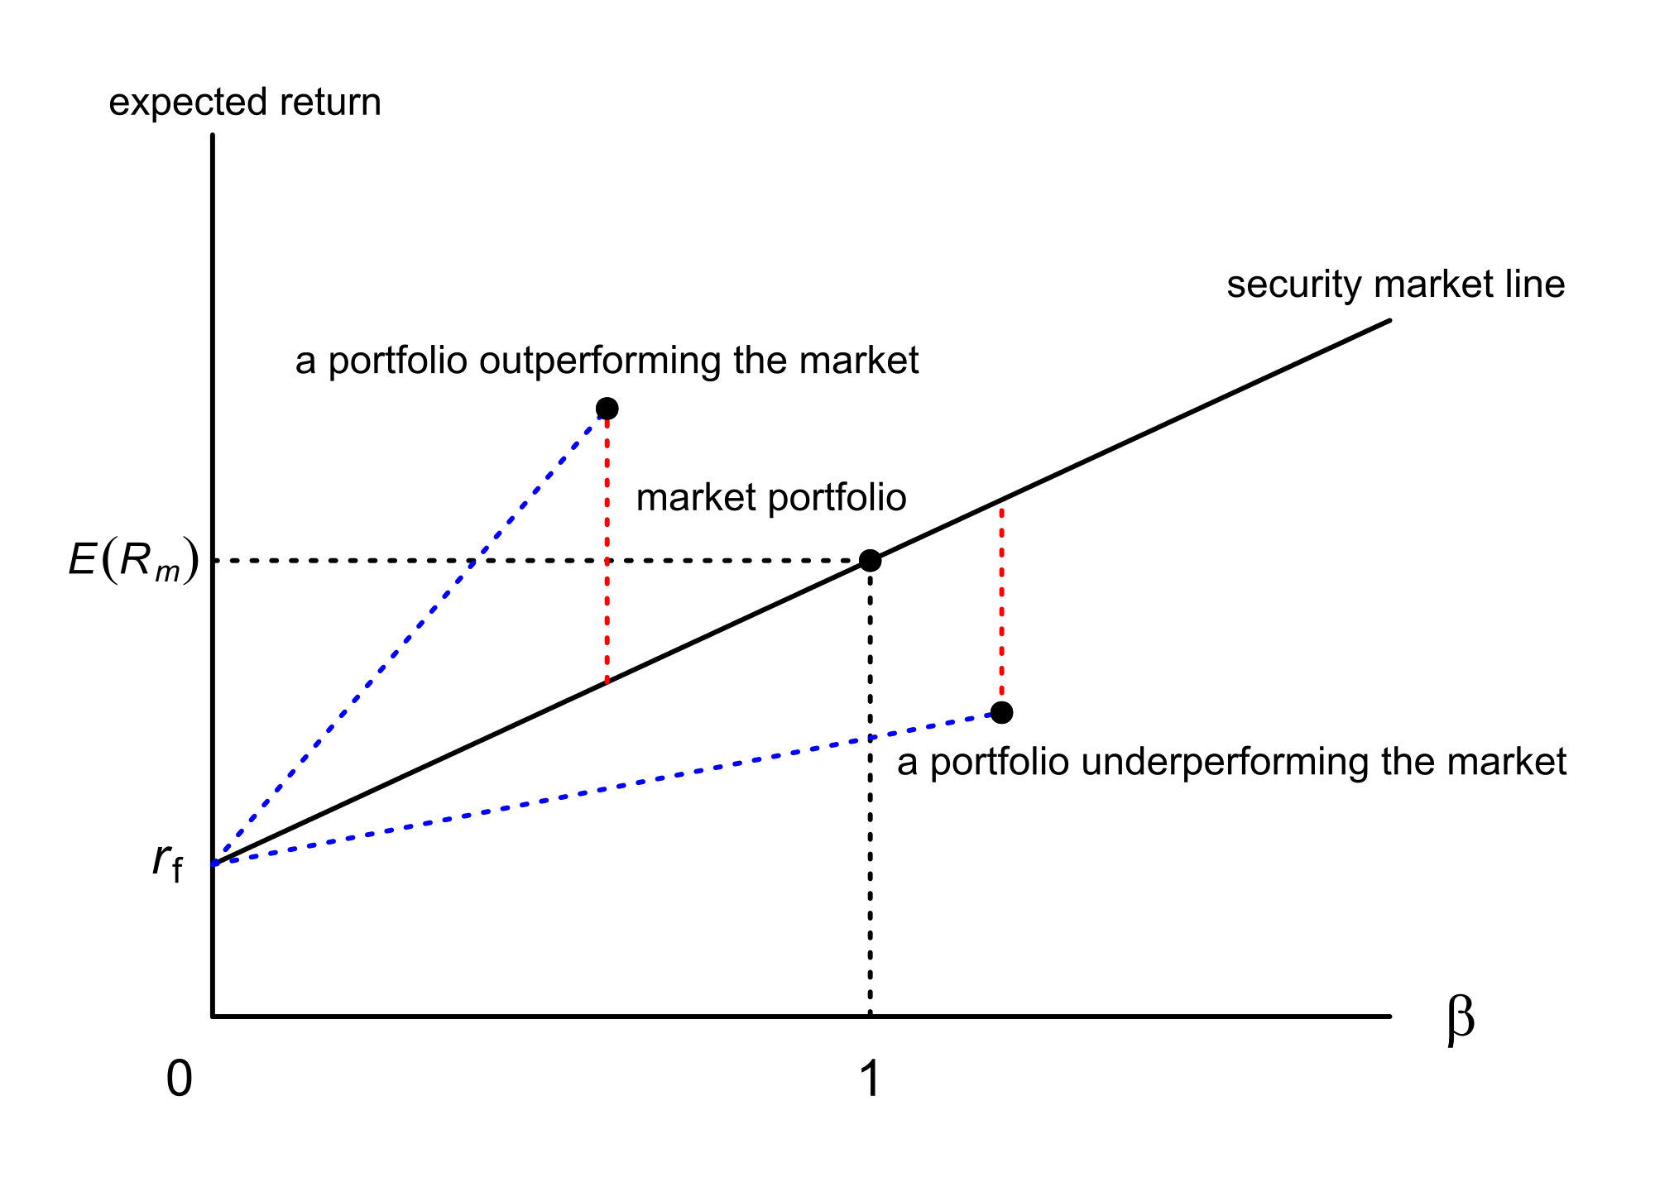
SML Review
Abnormal returns

Slide 3
Mean-Variance Review

Slide 4
Abstract
This paper analyze security market line (SML) deviations caused by superior performance based on superior information.
An uninformed observer using the tools of mean variance and SML analysis to measure the performance of a portfolio manager who has superior information is unlikely to be able to make any reliable inferences.
A manager with superior information can appear to be below or above the SML and inside or outside the mean-variance efficient frontier, and any combination of these is possible.

Slide 5
Section I What Can Go Wrong ?
A simple example to illustrates double for using SML analysis in the presence of market timing.

Slide 6
Assumptions
Consider a market only with two assets:
Riskless asset: return r (we will take r = 0)
Risky asset: return
π, risk premium, positive constant
s, market signal; , the signal observed by the manager
, unobserved noise term
and are independent normal random variables having mean zero and variance and
The manager has useful information ( > 0), and the manager’s information is not complete ( > 0)

Slide 7
Assumptions cont’d
The manager controls an initial investment of 1:
Riskless asset: 1-
Risky asset:
Market index or benchmark portfolio:
Riskless asset: 1-
Risky asset:
The market portfolio is assumed to be known to the observer and does not depend on s

Slide 8
Optimal Portfolio
Under a constant absolute risk-aversion utility function , for preferences A > 0
Given the signal s, to choose to maximize
Using the formula for the normal moment generating function and taking the log of minus the objective function, is equivalent to:
So the optimal portfolio is:
Quadratic equation with one unknown

Slide 9
Abnormal Return - as seen by observer
The unconditional abnormal return to the manager’s portfolio is:
Where
From SML

Slide 10
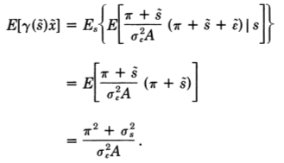
Abnormal Return - as seen by observer cont’d
The expected return to the manager’s portfolio:
The variance of the index:
$$Var\left(x\right)=E\left(x^{2}\right)−{[E\left(x\right)]}^{2}$$

Slide 11
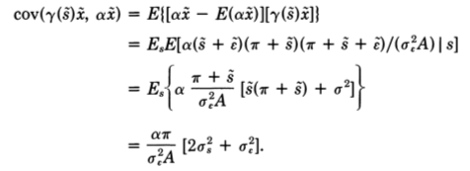
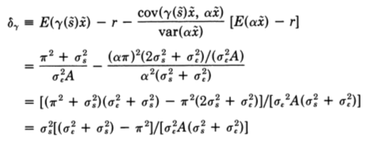
Abnormal Return - as seen by observer cont’d
The covariance of the manager’s return with this index,
The abnormal return of the manager’s portfolio:
Cov(X,Y)=E[(X-E(X)]*E[(Y-E(Y)]
Why not {γ(s)x - E[γ(s)x]} ?

Slide 12
Abnormal Return - as seen by observer cont’d
Since
Setting , abnormal return < 0. Therefore, the informed manager will plot below the observer’s SML.
Setting , abnormal return > 0. Therefore, the informed manager will plot above the observer’s SML.

Slide 13
Mean Variance - as seen by observer
The observed variance of the manager’s portfolios:
Since the manger’s portfolio has mean return and the return to any index is . When , index should have same return as the manager’s portfolio.
The variance of :

Slide 14
Mean Variance - as seen by observer cont’d
To get the difference between the two variances:
The expression is positive provided that . Therefore, the manager’s portfolio appears to the observer to be mean-variance inefficient since it has higher variance than a market portfolio having the same mean return.
Depending on the exact parameter values, this case may make the manager appear to the observer as mean-variance super-efficient, efficient, or inefficient.
$=σ_{s}^{2}[3π^{2}−σ_{ε}^{2}−σ_{s}^{2}(σ_{ε}^{2}$+$σ_{s}^{2})$/$π^{2}$]

Slide 15
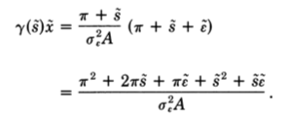
Why Paradoxical result?
Reexamine the returns to the manager’s portfolio:
Why non-normal distribution?
Returns are normal conditional on s, but the product of his portfolio choice as a function of s and the return as a function of s is no longer normally distributed.
What is the influence?
The term is skewed to the right and bounded below, the manager views this part of the return more favorably than the manager would view a normal random variable with the same mean and variance.
Chi-squared distribution

Slide 16
Section II What Can Go Right?
Define and analyze a general mean-variance framework with differential information.

Slide 17
Assumptions
There are n assets, the managed optimal portfolio is an n-vector of weights summing to one in every state s, i.e., with
Assume the portfolio choice, , is efficient, conditional on s.
The assets have an expected returns vector and returns covariance matrix .
Assume the observer is completely uninformed and forms expectations rationally, i.e., that the joint distribution of asset returns as viewed by the observer is the weighting across states, s, of the conditional distributions as viewed by the manager.

Slide 18
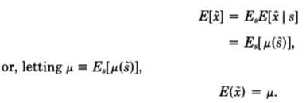
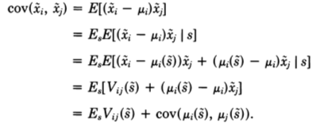
Returns and Covariance
Letting be the vector of random asset returns, the observer’s perception of average return is given by
The observer’s covariance of returns:

Slide 19
Returns and Covariance cont’d
Using the definitions
We have the returns variance-covariance matrix seen by the observer:
The observer sees as variability not only the average variability seen by the manager, V, but also the shift in the manager’s mean across states, Ω.
Since Ω is positive definite, the returns variance-covariance matrix implies that the observer faces more variability than does the manager, on average.

Slide 20
More General Formulas
For portfolios and
The mean return is
The covariance of returns is
=
≠

Slide 21
More General Formulas cont’d
So the abnormal returns computed using the manager’s expectations (i.e., expectations conditional on s) are given as
The result means intuitively that the source of difficulty in using abnormal returns analysis is that the observer cannot look at things from the perspective of the informed manager, i.e., cannot understand what the manager is doing without knowing the manager’s information.

Slide 22
Section III Positive Theorems on the Use of SML

Slide 23
Theorem 1
Suppose that is positively mean-variance efficient conditional on state s and that the return on a riskless asset in the economy is used for the riskless rate in defining abnormal returns. Then the conditional (on s) abnormal return , with equality if and only if the index portfolio is efficient conditional on s.

Slide 24
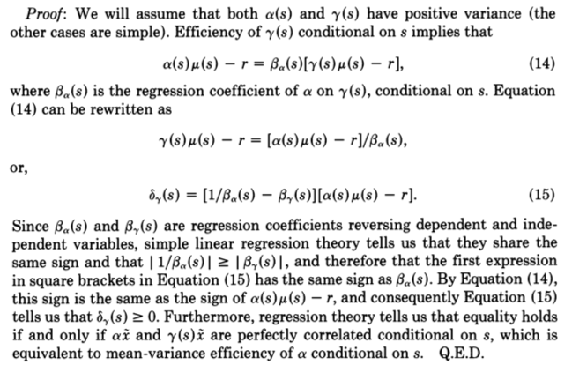
Proof

Slide 25
Theorem 2
Suppose that:
(a) There is a riskless asset, which is used for r in calculation .
(b) In each information sate s, the informed manager chooses a mean-variance undominated portfolio on the positive part of the efficient frontier conditional on s.
(c) The manager does not learn anything about the return or variance of the uninformed observer’s index, i.e., are independent of s.
(d) Expectations are rational and the rest of the framework is as given above.
It follows that , and the equality holds if and only if α is efficient conditional on every state.

Slide 26
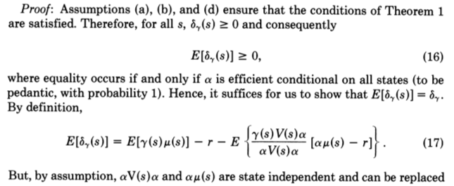
Proof

Slide 27
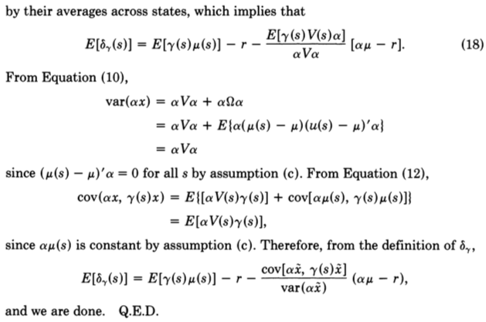
Proof cont’d

Slide 28
Section IV Summary and Conclusions

Slide 29
Summary and Conclusions
This paper has shown the fragile nature of SML analysis for the evaluation of performance. Even in the absence of statistical measurement problems, a manager who makes optimal uses of superior information may plot above, on, or below the SML and may plot inside, on, or outside the efficient frontier – and every combination of these case is possible.
If the reference portfolio is known to be efficient, a manager plotting above the SML necessarily has differential information, but we cannot tell whether or not that information is being used correctly.

Slide 30
What should we require of a new performance measurement technique ?
First, it should correctly identify superior, ordinary, and inferior performance.
Second, it should be immune to gaming, i.e., it should work correctly even when the manager being evaluated understands the measure being used.
Finally, the measure should be sufficiently powerful to be useful in practice.
While there are promising measures satisfying the first two requirements, the last requirement is likely to be the ultimate stumbling block since there is large amounts of noise.

